Slide 1

Welcome to Kenai Central High School Library
Lets make 2023-2024
An Amazing year!
Ms. Gann

Slide 2

Today’s Objectives
Introduction to library
Locating resources
Reference materials
Library procedures
KCHS Alexandria – library catalog
Visit KCHS Library Web Page
Put a book on Hold Alexandria
Canvas log in on KPBSD website

Slide 3
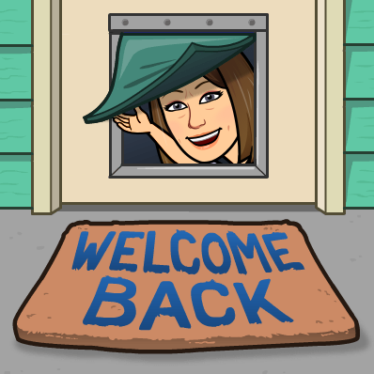
Library Staff and Hours
Library Staff
  Librarian: Ms. Gann
  T TH & F am
  Assistant: Mrs. Crouse
  M W & F pm
Hours: 7:30 – 2:30
Study Hall M-Th 2:30 – 3:30
Teacher there to help you
*sign in and out please during study hall

Slide 4

Expectations
Work quietly and stay on task
Please sign in and out on computer
No Food and beverages at computers
Use email for school-related projects
Use the internet responsibly, abiding by KCHS and KPBSD internet guidelines
Please clean up your area and push in your chair when you leave
Clean up after yourself at lunch

Slide 5

Lunch in the Library
No food or drink at computers
Wipe down your table after use
Throw your trash in the Garbage
Follow all instructions from staff
Keep your library neat and tidy it is a fabulous library
Push in chairs
Return chairs to original destinations
See something on the floor pick it up

Slide 6

Location of Materials?
Biographies (B) – Back Wall left side
Fiction (DEW) 5 Tall Shelves left side
Non-Fiction (000.0 A-999.9) – 5 Tall stacks right side
Reference (R) – short wall by Circulation desk
Supplies – tables around the library
Book return – circulation desk
Printer - Library 227 on Sharon add with settings
Sign in Computer by circulation desk

Slide 7

Find a Book?
Go to KCHS Library webpage
Find Alexandria Researcher Link on each student desktop
Login with student number and last name
Link to researcher on school district page
Browse the shelves or place hold
Ask a friend or classmate
Ask a teacher or librarian for help

Slide 8

Check out
Bring book to front counter
Type or scan your id in the wireless keypad
Date due gets stamped
Return or renew it in 3 weeks
May check out 6 books or more if needed just ask
No one at the desk put your name and id on a sticky with the book barcode and we will check it out for you

Slide 9

How Do I Renew a Book?
…….it is really simple!
Bring it in or let us know and we will renew it for you
Go online and renew it yourself
Log in to Alexandria on your desktop! Your id and your last name is your password.

Slide 10

Helpful Research Tools
(The following can be accessed from home, too!)
Accessed through our Library webpage:
Alexandria Researcher
World Book Online
Gale Databases
Discovery Education
SLED password sheet in library if needed
  Databases
  Magazines
  Live Homework Help
  Resources in Context

Slide 11

Visiting the Library
With your class sit in the area assigned by your teacher
Coming with a pass sign in on the computer by each door. Sign in individually on google form.
We keep track of numbers
Clean your area when leaving
Communicate you are returning to class

Slide 12

Using Computers?
You have an KPBSD Internet Use permission form on file
Need to print: use Library 227 on Sharon
If you need to add the computer make sure it is the library 227
Please no playing games during class time

Slide 13

Printing from a computer?
Copy what you need into word document before printing from internet
Choose the correct printer:
go to settings on your computer click on devices > printers/scanners >click add printer > find 07 Library 227 on Sharon >click on it then open the document again and print.

Slide 14

Other Library Services
Scan on copier and email to yourself
Copy things that you need multiple copies of for class
Inter-Library Loans
  We don’t have the book ( we can get it from other libraries in the district)

Slide 15

Sora @KCHS
Electronic Books
Audio Books
Magazines
Guttenberg Books
Sora App to use
Add KPBSD Schools as location
99669 is the Zipcode
Library Sora : Sign in with regular computer User Name and password
Teachers use a 9 instead of the E

Slide 16

KPBSD Resources Available
Kenai Peninsula Borough School District
Worldbook
Discovery Education
Canvas

Slide 17

Do You Have Any Questions?
Locating resources
Library procedures
Alexandria online catalog
Library webpage
How to check out a book
Where to return a book
Who can help you

Slide 18

Please let us know how we can help!
Email Ms. Gann

