Slide 1

Welcome to Kenai Central High School Library
Lets make 2021-2022
a fabulous year!
Ms. Gann

Slide 2

Today’s Objectives
Introduction to library
Locating resources
Reference materials
Library procedures
KCHS Alexandria – library catalog
Visit KCHS Library Web Page
Put a book on Hold Alexandria
Canvas log in on KPBSD website

Slide 3
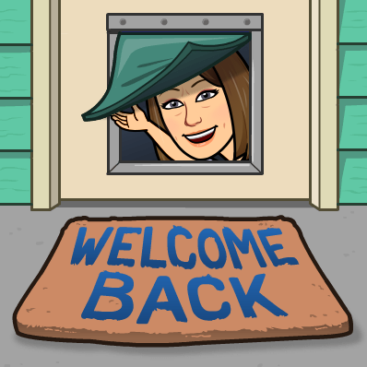

Library Staff and Hours
Library Staff
Librarian: Ms. Gann
T TH & F am
Assistant: Mrs. Brown
M W & F pm
Hours: 7:30 – 2:30
Study Hall M-Th 2:30 – 3:30
*sign in and out please during study hall

Slide 4

Expectations
Work quietly and stay on task
Please sign in and out on computer
No Food and beverages
Use email for school-related projects
Use the internet responsibly, abiding by KCHS and KPBSD internet guidelines
Please clean up your area and push in your chair when you leave

Slide 5
Protocol Library
Clean your computer after use
Need a book place hold on Alexandria
Follow all instructions from teachers and staff

Slide 6

Lunch in the Library
Sit at tables or booths
No food or drink at computers
Wipe down your table after use
Follow all instructions from staff
Keep your library neat and tidy it is a fabulous library
Please remind each other to push in chairs and leave their area clean! If you see something on the floor pick it up!

Slide 7

Location of Materials?
Biographies (B) – Back Wall left side
Fiction (DEW) 5 Tall Shelves left side
Non-Fiction (000.0 A-999.9) – 5 Tall stacks right side
Alaska Collection (AK)– 979 in nonfiction
Reference (R) – short wall by Circulation desk
Encyclopedias – In Reference
Supplies – tables around the library
Book return – circulation desk
Printer - Library 227 on Sharon
Sign in Computer each end of Lab A

Slide 8

Find a Book?
Go to KCHS Library webpage
Find Alexandria Researcher Link on each student desktop
Browse the shelves or place hold
Ask a friend or classmate
Ask a teacher or librarian for help

Slide 9

Check out
Bring book to front counter
Type or scan your id in the wireless keypad
Date due gets stamped
Return or renew it in 3 weeks
May check out 6 books or more if needed just ask

Slide 10

How Do I Renew a Book?
…….it is really simple!
Bring it in or let us know and we will renew it for you
Go online and renew it yourself
Log in to Alexandria on your desktop! Your id and your last name is your password.

Slide 11

Helpful Research Tools (The following can be accessed from home, too!)
Accessed from our Library webpage:
Alexandria Researcher
World Book Online
Gale Databases
Discovery Education
SLED
Databases
Magazines
Live Homework Help
Resources in Context

Slide 12
Visiting the Library
With your class sit in the area assigned by your teacher
Coming with a pass sign in on the computer by each door. Sign in individually
We keep track of numbers
Clean areas when leaving
Communicate you are returning to class

Slide 13

Using Computers?
You have an KPBSD Internet Use permission form on file
All usage must be school-related
No playing games during class time
Classes have priority over individuals with passes

Slide 14

Printing from a computer?
Print your school work
Pick up printing from copier by library office
Copy what you need into word document before printing from internet
Choose the correct printer go to settings on your computer to add printer
07 Library 227 on Sharon

Slide 15

Other Library Services
Emailing scanned copy
Copy things that you need multiple copies of for class
Laminating – cost varies
Inter-Library Loans (from other libraries in the district)

Slide 16

Overdrive @KCHS
Electronic Books
Audio Books
Guttenberg Books
Sora App to use
Add KPBSD Schools as location
Library Sora Sign in with computer User Name and password

Slide 17

KPBSD Resources Available
Kenai Peninsula Borough School District
Worldbook
Discovery Education
Canvas

Slide 18

Do You Have Any Questions?
Locating resources
Library procedures
Alexandria online catalog
Library webpage
How to check out a book

Slide 19

Please let us know how we can help!
Email Ms. Gann

